Slide 1
CPS 235 Object Oriented Programming Paradigm
Lecturer Rabia Khan
Classes (Part I)
CPS235:Classes

Slide 2
Contents
Building Classes
Defining Objects
Constructors
Objects as Function Arguments
Using Default Parameters in Functions
Returning Objects from Functions
CPS235:Classes

Slide 3
Problem Statement
Write a program that reads a temperature (either Fahrenheit or Celsius), and displays that same temperature in both scales
CPS235:Classes

Slide 4
Preliminary Analysis
A temperature has two attributes:
  its magnitude (a double), and
  its scale (a character)
When an object cannot be directly represented by any of the available types, build a class!
CPS235:Classes

Slide 5
Building Classes
Begin by defining variables to store the attributes of the object being represented (a temperature)
double magnitude;
char scale;
CPS235:Classes

Slide 6
Building Classes
We then wrap these variables in a class declaration:
    class Temperature
    {
    public:
    private:
    double magnitude;
    char scale;
    };
When declared within a class declaration, such variables are called class data members
Declaring this class does not allocate memory for a Temperature
It just tells the compiler what temperature is and what are its attributes
CPS235:Classes

Slide 7
Data Hiding
Hiding data from parts of the program that do not need to access it
Classes have a public section and a private section
Items (data or functions) declared in the public section are accessible to users of the class i.e., they can be accessed from outside the class
Items declared in the private section are inaccessible to users of the class i.e., they can only be accessed from within the class
Data members should go in the private section, to prevent programmers from writing programs that access data members directly
All class members are private by default
CPS235:Classes

Slide 8
Defining an Object
A programmer can now write:
Temperature aTemp;
and object aTemp can be visualized as follows:
aTemp
magnitude
scale
The data members magnitude and scale within aTemp are uninitialized
CPS235:Classes

Slide 9
Classes versus Objects
An object has the same relationship to a class as a variable has to a data type
An object is said to be an instance of a class
As you don’t assign values to types rather to variables
  int = 5; //wrong
  int x = 5; //right
Similarly an object of a class has to be created before it can be assigned any values
Temperature aTemp;
aTemp.magnitude = 37.0;
CPS235:Classes

Slide 10
Member Functions
Operations on a class object are usually implemented as class member functions
A call to a member function:
Object.Function()
  can be thought of as the caller sending the object Object a message named Function.
  The definition of a function member details what Object does in response to the message.
CPS235:Classes

Slide 11
Member Functions
Let’s say we want to display the values of a Temperature Object using a display function
    aTemp.display();
void display()
{
cout << “Magnitude:” <<magnitude ;
cout <<“ ,Scale:” << scale;
}
The function returns nothing, so its return-type is void
CPS235:Classes

Slide 12
Member Function Prototypes
class Temperature
{
public:
void display();
private:
double magnitude;
char scale;
};
By declaring the prototype within the class, we tell the compiler that class Temperature has a function member named display()
Most function prototypes go in the class public section
CPS235:Classes

Slide 13
Exercise....
class CRectangle
{ int x, y;
public:
void set_values (int,int);
int area ()
{return (x*y);}
};
void CRectangle::set_values (int a, int b)
{ x = a; y = b; }
int main ()
{
CRectangle rect;
rect.set_values (3,4);
cout << "area: " << rect.area();
return 0; }
CPS235:Classes

Slide 14
Problem
At present, a Temperature declaration:
Temperature aTemp;
leaves aTemp’s data members uninitialized
To auto-initialize them to a default value (e.g., 0C), we can use a special function called a constructor
CPS235:Classes

Slide 15
Constructors
A constructor function is a class member function whose task is to initialize the class data members
Temperature()
{
magnitude = 0.0;
scale = ‘C’;
}
Since it returns nothing, a constructor has no return type (not even void)
The name of a constructor is always the name of the class (in this case Temperature())
CPS235:Classes

Slide 16
Constructor Prototype
class Temperature
{
public:
Temperature();
void display();
private:
double magnitude;
char scale;
};
Since they specify the first thing a user of the class needs to know (i.e., how to define class objects), constructor prototypes are usually the first function members listed in the public section of the class
CPS235:Classes

Slide 17
Object Definitions
A programmer can now write:
Temperature aTemp;
and object aTemp can be visualized as follows:
aTemp
magnitude
0.0
scale
C
The class constructor is automatically called whenever a class object is defined
CPS235:Classes

Slide 18
Problem 2
At present, we can only initialize a Temperature to a default value:
Temperature aTemp;
We have no means of initializing a Temperature to any other value.
To initialize a Temperature to a particular value (e.g., 98.6F), we can overload the constructor with a second definition
CPS235:Classes

Slide 19
Constructor 2 Definition
To overload the constructor, we just provide a second definition (and prototype) that differs from all other constructors in at least one parameter
To initialize the data members of our class, this second constructor must receive the initial values via its parameters
Temperature(double mag, char sc)
{
assert(sc == ‘F’ || sc == ‘C’);
magnitude = mag;
scale = sc;
}
CPS235:Classes
Notes:
void assert (int expression);
Evaluate assertion
If the argument expression of this macro with functional form compares equal to zero (i.e., the expression is false), a message is written to the standard error device and abort is called, terminating the program execution.

Slide 20
Constructor 2 Prototype
class Temperature
{
public:
Temperature();
Temperature(double mag, char sc);
void display();
private:
double magnitude;
char scale;
};
The same name can be used to define different functions, provided the signature (the list of the parameter types) of each function is different
CPS235:Classes

Slide 21
Object Definitions
A programmer can now write:
Temperature temp1, temp2(98.6, ‘F’);
and temp1 and temp2 are defined as follows:
temp1
magnitude
0.0
temp2
magnitude
98.6
scale
C
scale
F
The compiler uses the number of arguments in a declaration to decide which constructor to use in initializing an object
CPS235:Classes

Slide 22
Testing
To test this, we can write in main()
void main()
{
Temperature temp1, temp2(98.6, ‘F’);
temp1.display(); // displays Magnitude:0, ScaleC
cout << endl;
temp2.display(); // displays Magnitude:98.6,Scale:F
}
CPS235:Classes

Slide 23
Placing function definition within class definition
You can also place the definition of a function into the declaration of the class which automatically makes the function inline
class Temperature
{
private:
double magnitude;
char scale;
public:
Temperature()
{
magnitude = 0.0;
scale = ‘C’;
}
void display() {
cout << “Magnitude:” <<magnitude ;
cout <<“ ,Scale:” << scale;
}
    };
CPS235:Classes

Slide 24
Another way to define a constructor
class Temperature
{
private:
double magnitude;
char scale;
public:
Temperature(): magnitude (0.0), scale(‘C’)
{ /*empty body*/ }
Temperature(double mag, char sc): magnitude(mag),scale(sc)
{assert(sc ==‘F’ || sc == ‘C’}
void display();
};
CPS235:Classes

Slide 25
No-Arg Constructor
If you don’t explicitly define any constructors, the compiler automatically generates a default constructor that takes no arguments
So in case you do not define any constructors and simply create a Temperature object
      Temperature aTemp;
The compiler will call a default constructor which does not, however, assign any values to the data members
But once you’ve defined even one kind of constructor (may be a 2-arg constructor), the compiler will no longer create a default no-arg constructor for you
CPS235:Classes

Slide 26
No-Arg Constructor
E.g., if I remove the following from my class declaration
Temperature(): magnitude (0.0), scale(‘C’)
{ /*empty body*/ }
And then try to execute the following in main()
      Temperature t1;
      Temperature t2(98.6,’F’);
This will give a compile time error
CPS235:Classes

Slide 27
Default Arguments/Parameters
Any C++ function can provide default values for its input function arguments
If a value is not specified in a function call, the default value is assigned and sent to the called function
CPS235:Classes

Slide 28
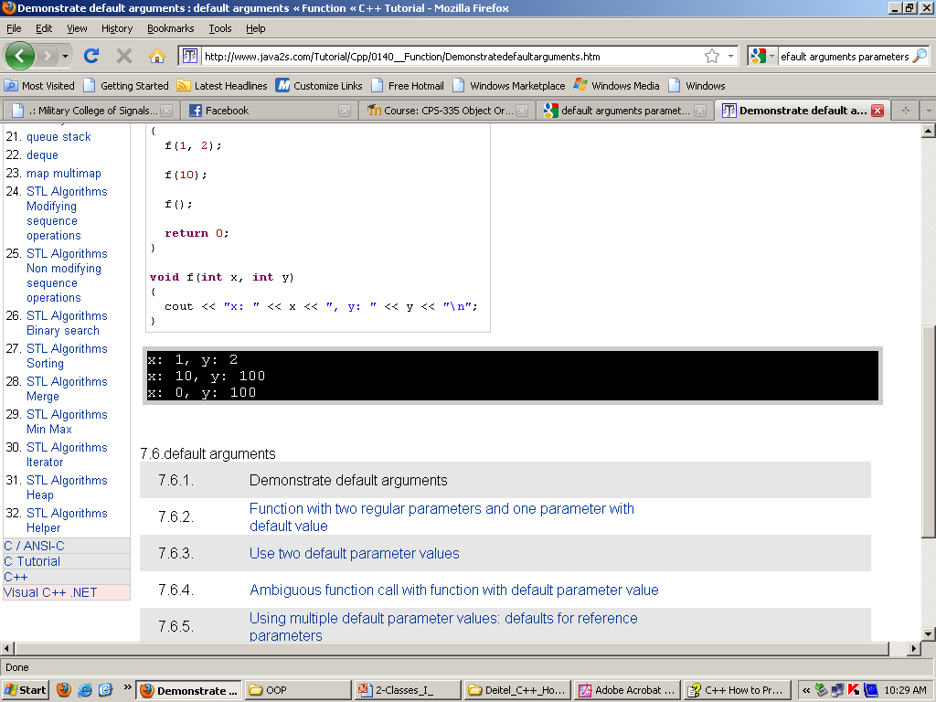
Default Arguments/Parameters
void f(int x = 0, int y = 100);
int main()
{
f(1, 2);
f();
return 0;
}
void f(int x, int y)
{ cout << "x: " << x << ", y: " << y << "\n"; }

Slide 29
Default Arguments/Parameters
When the compiler processes the add function it does not “see” any values provided for the two arguments. As a result, it assigns the default values, 10 and 2, to a and b when calling the function. Users, however, can override the default values by providing their own values in the function call. As a result, the same function can look very different when it is called
#include <iostream>
int add( int a=10, int b=2 );
void main()
{
int f1 = add();
cout << f1 << endl;
}
int add( int a, int b )
{
return (a+b);
}
Output
12
void main()
{
int f1 = add();
int f2 = add( 14, 7);
cout << f1 << “ “ << f2 << endl;
}
Output
12 21

Slide 30
Default Arguments/Parameters
However this code might spark confusion and give a compile time error for example in the following scenario.
int add( int a=10, int b );
void main()
{
int f1 = add( 20 );
cout << f1 << endl;
}
int add( int a, int b )
{
return (a+b);
}
Therefore for multiple arguments there should be a rule. The rule is on the next slide.
When the compiler encounters the function call, which argument (a or b) should it assign the value 20?

Slide 31
Default Arguments/Parameters
The rule is enforced when using default values and multiple arguments.
All arguments to the right of an argument with a default value must be specified in the function prototype
In other words, their can be no "holes" in your default parameter list
  This rule helps the compiler determine which arguments to assign values to in a function call
Correcting our example according to this rule, we now have
With this rule, values specified will be assigned to arguments beginning from the left. In this example, the value 20 is assigned to a and the default value 2 is assigned to b
int add( int a, int b=2 );

Slide 32
Identify the error and Correct….
#include <iostream>
int add( int a, int b=2, int c );
void main()
{
int f1 = add( 20 );
cout << f1 << endl;
}
int add( int a, int b, int c )
{
return (a+b+c);
}
int add( int a, int b=2, int c=4 );
Since we have not specified a value for c according to the rule, the compiler reports an error

Slide 33
Using Default Parameters
We can “combine” two functions (constructor without parameters and constructor with parameters) using default parameters of C++
Constructor for the Temperature class
The prototype in the class definition would be
    Temperature(double mag=0.0, char sc='C');
The function definition would be
  Temperature::Temperature(double mag,char sc)
  {
    assert(sc == 'F' || sc == 'C');
    magnitude = mag;
    scale = sc;
  }
CPS235:Classes

Slide 34
Using Default Parameters
In our main function, we can write:
int main()
{
Temperature t1;
Temperature t2(100.0);
Temperature t3(100.0,'F');
t1.display();
t2.display();
t3.display();
getch();
return 0;
}
CPS235:Classes

Slide 35
Objects as Function Arguments
Class Distance
{
private:
int feet;
float inches
public:
Distance() : feet(0),inches(0.0)
{ }
Distance(int ft,float in):feet(ft),inches(in)
{ }
CPS235:Classes

Slide 36
Objects as Function Arguments
void getdist ( )
{
cout <<“\nEnter feet : “; cin >> feet;
cout <<“\nEnter inches : “; cin >> inches;
}
void showdist ( )
{
cout <<feet << “ \‘ - << inches <<“\” “;
}
void add_dist(Distance, Distance);
};
CPS235:Classes

Slide 37
Objects as Function Arguments
void Distance :: add_dist(Distance d2, Distance d3)
{ inches = d2.inches + d3.inches;
feet =0;
if (inches >= 12.0)
{ inches -= 12.0;
feet++;
}
feet += d2.feet + d3.feet;
}
CPS235:Classes

Slide 38
Objects as Function Arguments
void main( )
{
Distance dist1, dist3;
Distance dist2(10, 3.5);
dist1.getdist( );
dist3.add_dist(dist1, dist2);
cout <<“\ndist1 = “ ; dist1.showdist( );
cout <<“\ndist2 = “ ; dist2.showdist( );
cout <<“\ndist3 = “ ; dist3.showdist( );
}
CPS235:Classes

Slide 39
Returning Objects from Functions
Distance Distance :: add_dist(Distance d2)
{
Distance temp;
temp.inches = inches + d2.inches;
if (temp.inches >= 12.0)
{ temp.inches -= 12.0;
temp.feet =1;
}
temp.feet += feet + d2.feet;
return temp;
}
int main()
{
Distance dist1,dist2;
Distance dist3(11,6.5);
dist1.getdist(); //from user
dist2 = dist1.add_dist(dist3);
return 0;
}
CPS235:Classes

Slide 40
Compulsory Reading
Robert Lafore, Chapter 6: Objects and Classes
CPS235:Classes

